Slide 1

Basics of Patents and Searches
(How to get best out of the patchwork)
February 5, 2015
Presented by,
Syed Murtuza, Lead Patent Analyst – Level 2, ipMetrix Consulting Group
syed@ipmetrix.com
Mobile: +91-8892649982

Slide 2

Speaker Today
Syed Murtuza
Lead Patent Analyst – Level 2 (www.ipMetrix.com)
More than 5 years experience as an IP professional
Cisco and Microsoft Certified Technology Specialist
Vast experience in writing and prosecuting applications
Vast experience in Research and Litigation
Published journal articles in technology and law
Conducted IP awareness programs in various companies and colleges
Conducted IP training workshops in various companies
Applied patent applications for technologies
M. Tech, JNTU
https://in.linkedin.com/in/syedmurtuza

Slide 3
Agenda
1
Patentability Criteria
2
Types of Searches
3
Application for Patents
4
Types of Patent Applications
5
Patent Process

Slide 4
Agenda
1
Patentability Criteria
2
Types of Searches
3
Application for Patents
4
Types of Patent Applications
5
Patent Process

Slide 5

Got an Inventive Idea?
If you have an invention or inventive idea
What do you do?
Publish a Paper
Start Manufacturing
Protect your invention
Apply for Patent

Slide 6

Patent
A patent is a statutory grant by Govt for new inventions conferring certain monopoly rights on the grantee for a defined period, subject to certain conditions
Patent rights are territorial
Term: 20 years from date of filing
Aim
  Encourage industrial development
  Encourages complete disclosure
  Prevents duplication
  Focus on commercial relevance
  Prevents exploitation of researchers
  Revenue generation
  Source of technical information

Slide 7

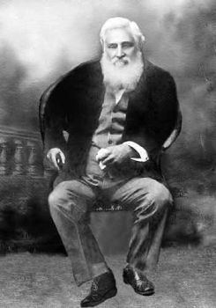
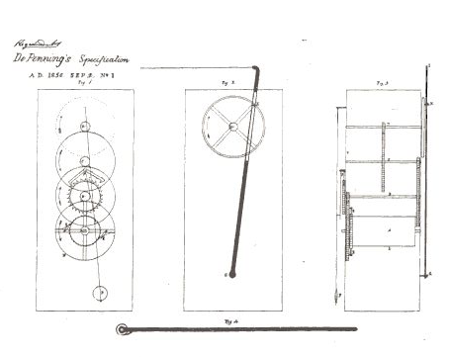
A punkah pulling machine (February 28, 1856)
George Alfred DePenning

Slide 8



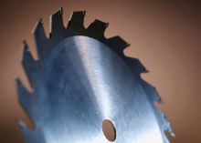





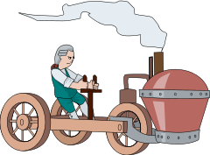



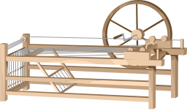






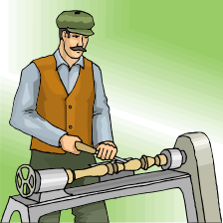

Who Needs Patents?
New Ways to Make
New Applications

Slide 9
What Can Be Patented
Process or Method
Machine or Apparatus
Article of Manufacture
Composition of Matter
  Chemical Compounds
  Physical Mixtures
Improvements of Any of the Above

Slide 10
Patentability Criteria
Industrial utility
Non-obviousness
Novel
Subject matter
Novel
No prior use/claim/ publication
Capable of being made or used in industry & reproduced with the same characteristics as many times as necessary
Subject matter
used
Should be non-obvious to a person skilled in the art
-Technical advancement
-Economic significance
“Any thing under the sun cannot be patentable”

Slide 11
Novelty
Novelty mean that the subject matter SHOULD NOT BE
  PUBLISHED IN ANYWHERE IN THE WORLD PRIOR TO THE PATENT APPLICANT INVENTING IT
  IN PRIOR PUBLIC KNOWLEDGE OR PRIOR PUBLIC, BUT NOT NECESSARILY PATENTED OR PUBLISHED
  USE, SALE, MANUFACTURE, & DEVELOPED ANYWHERE IN THE WORLD
  CLAIMED BEFORE IN A PATENT SPECIFICATION ANYWHERE IN THE WORLD
A Novel subject is not part of state of the art.
(state of the art comprise product, process, or information
in public domain)

Slide 12

Novelty Search
Novelty is determined before inventive step (or Non-obviousness) because the creative contribution of the inventor can be assessed only by knowing the novel elements of the invention
The Novelty Search is conducted to see whether the invention is anticipated by any prior art

Slide 13

What are Anticipations
Anticipation
Dictionary Meaning:
A prior action that takes into account or forestalls a later action
Visualization of a future event or state
Meaning w.r.t. to Patents:
Any description of the invention which destroys the element of novelty of the invention

Slide 14

Anticipation criteria to determine novelty
If it was available publicly before the priority date
Planting the flag test
  Prior publication shall have clear and unmistakable direction to do what patentee claims to have invented
  Sign post to invention is not enough
  Prior inventor must be clearly shown to have planted his flag at precise destination and before the patentee

Slide 15
Doctrine of anticipation to determine novelty
35 U.S.C. 102 sets forth the doctrine of anticipation by requiring novelty of invention.
Doctrine of anticipation
“A claim is said to be “anticipated” if comparison of the claimed invention with a prior art reference reveals that each and every element in the claim under attack is shown or described, organized, and functioning in substantially the same manner as in the prior art reference”

Slide 16
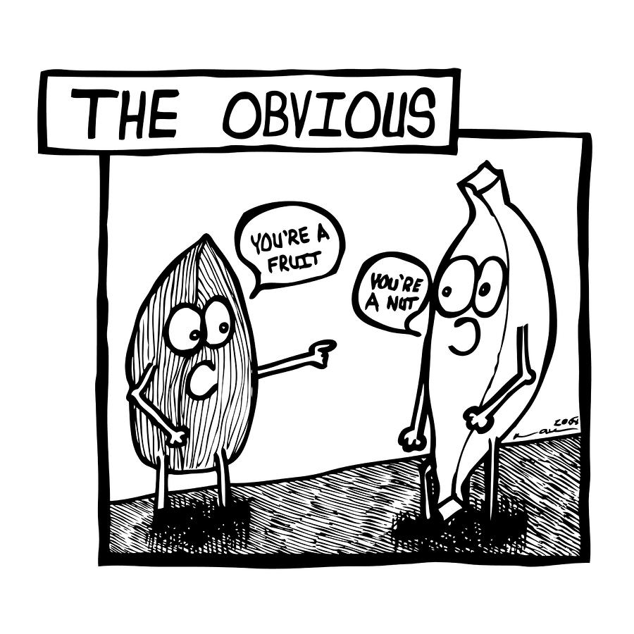
The Non-obviousness Requirement
Even if the invention demonstrate patentable subject matter, utility and novelty, the patent will not issue if the invention is obvious
“Obviousness is the next step in the road to patentability, and a significant hurdle”

Slide 17
The Non-obviousness Requirement
What is obviousness?
“An invention is obvious if the differences between the subject matter sought to be patented and the prior art are such that the subject matter as a whole would have been obvious at the time the invention was made to a person having ordinary skill in the art to which said subject matter pertains.”
Not exactly but rather known if one were to combine several references.
Obviousness defines predictable and non-unique combination of what multiple references teach would yield your invention.
Notes:
The current Examination Guidelines defines a person skilled in the art as follows.
In determining non-obviousness of the invention, the Examination Guidelines, Part II, Section 2.2(2) prescribes that a person skilled in the art is a hypothetical person who has a common general knowledge in the art at the time of filing the application and ability to use ordinary technical means for research and development, can exercise ordinary creative ability in selecting materials and changing designs, is capable of comprehending all technical matters in the state of the art at the time of filing the application, and is capable of comprehending all technical matters in the field of technology relevant to the problem to be solved by the invention.
Thus, Examiner is not considered to be a person of ordinary skill in the art, but Examiner is supposed to carry out the examination taking the knowledge of such hypothetical person into consideration.

Slide 18
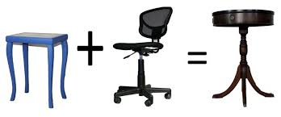
The Non-obviousness Requirement
Example:
When you have invented A+B.
A is known in the prior art, and B is known in the prior art.
Upon looking at A and then looking at B, would someone of skill in the art consider A+B to be already known?
If the answer is yes, then A+B is obvious.
If the answer is no, then A+B is not obvious.

Slide 19
Some more rules to determine obviousness
The differences between the prior art and challenged claims;
The level of ordinary skill in the field of the pertinent art at the time of plaintiff’s invention;
What one possessing that level of skill would have deemed to be obvious from the prior art reference;
Objective evidence of obviousness or non-obviousness;
Objective evidence includes: (1) the commercial success of the invention; (2) whether the invention satisfied a long felt need in the industry; (3) failure of others to find a solution to the problem at hand; and (4) unexpected results.

Slide 20
Determining what would have been obvious to a person of ordinary skill in the art
The decision maker may examine the following factors:
Type of problems encountered in the art;
Prior art solutions to those problem;
Rapidity with which innovations are made;
Sophistication of the technology;
Educational level of the inventor; and
Educational level of active workers in the field.

Slide 21

Subject Matter
The patents Act 1970 doesn't define the category of the inventions that can be patented
But provides a list of inventions that cannot be patented.
Idea behind preventing certain inventions from patentability is to prevent monopoly over inventions which are injurious to health, environment, morality, national defense & security.
NOT
PATENTABLE

Slide 22
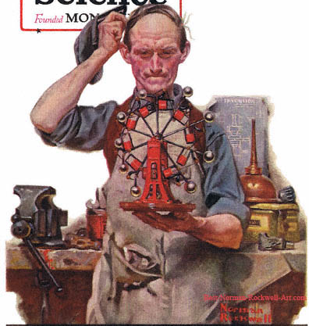
Inventions not Patentable
What are not inventions (Section 3)
Frivolous invention or which claims anything obvious contrary to well established natural laws
Ex: Machine giving output without input,
merely making in one piece, articles previously made in two or more pieces is frivolous (mere usefulness is not sufficient),
a machine allegedly giving 100% performance

Slide 23


Inventions not Patentable
Section 3: What are not inventions (contd.)
Use or commercial exploitation is contrary to public order or morality or causes prejudice to human, animal or plant life or health or to the environment
Ex: Method of committing theft, counterfeiting currency notes, gambling, adulteration of food, device for house-breaking, Terminator gene technology

Slide 24
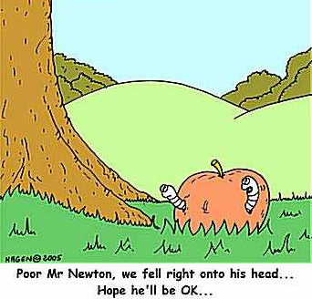
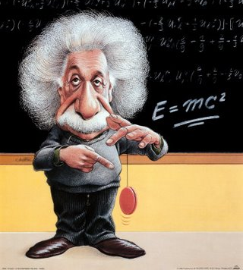
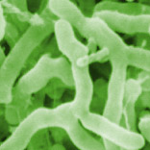
Inventions not Patentable
Section 3: What are not inventions (contd…)
The mere discovery of a scientific principle or the formulation of an abstract theory or discovery of any living things or non-living substance occurring in nature
Ex:
  Newton’s Laws
  Einstein’s equation
  a substance or micro-organism occurring freely in nature is a discovery.
Notes:
Discovery vs. invention
A discovery adds to the amount of human knowledge by disclosing something already existent, which has not been seen before, whereas an invention adds to the human knowledge by creating a new product or processes involving a technical advancement as compared to the existing knowledge.
A claim for discovery of scientific principle is not considered patentable, but such a principle when used with process of manufacture resulting into a substance or an article may be patentable.
Ex: finding of a new substance or micro-organism occurring freely in nature is a discovery and not an invention.

Slide 25
Inventions not Patentable
Section 3: What are not inventions (contd…)
the mere discovery of a new form of a substance which does not result in the enhancement of a known efficacy of that substance
or
the mere discovery of a new property
or
new use of a known process, machine or apparatus unless such known process results in a new product or employs at least one new reactant.
Page 25 of 66

Slide 26
Inventions not Patentable
Section 3: What are not inventions (contd…)
Section 3rd…
For the purposes of this clause, Salts, esters, ethers, polymorphs, metabolites, pure form, particle size, isomers, mixture of isomers, complexes, combinations and other derivatives of known substances shall be considered to be same substance, unless they differ significantly in properties w.r.t. efficacy.
Ex:
  Amorphous to crystalline and vice versa
  One isomer to other isomer
  Hygroscopic to dried
  New use of Aspirin for heart ailments
  Mere new uses of Neem.

Slide 27
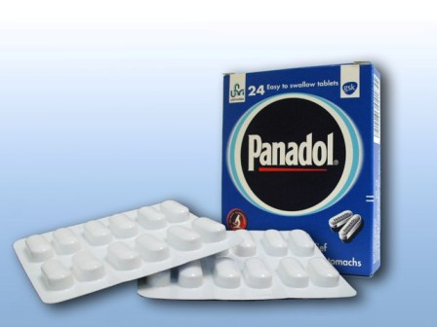
Inventions not Patentable
Section 3: What are not inventions (contd…)
A substance obtained by a mere admixture resulting only in the aggregation of the properties of the components thereof or a process for producing such substance
Ex: Mixture of medicines to cure multiple diseases without synergy, Combiflam [Paracetamol (Antipyretic) + Brufen (analgesic)], Solution of sugar and color additives in water to form a soft drink.
However, an admixture resulting into synergistic properties of mixture is not considered as mere admixture e.g soap, detergent, polymer compositions etc.

Slide 28
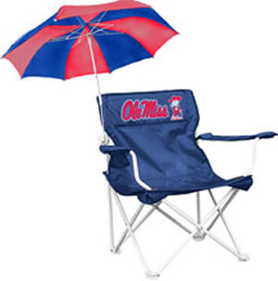
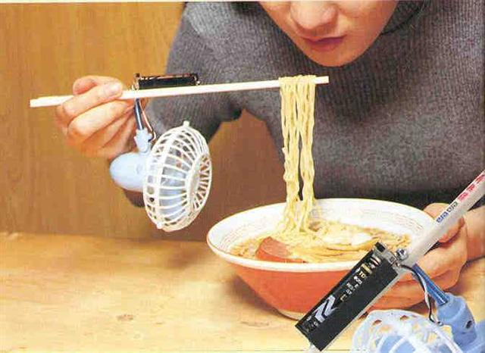

Inventions not Patentable
Section 3: What are not inventions (contd…)
Mere arrangement or re-arrangement or duplication of known devices each functioning independently of one another in a known way.
Ex: Bucket with torch, Clock with transistor etc
A method of agriculture/horticulture.
Ex: Method of making mushroom, algae, producing new form of a known plant.
Agricultural equipments are patentable

Slide 29
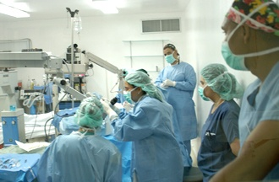
Inventions not Patentable
Section 3: What are not inventions (contd…)
Any process for the medicinal, surgical, curative, prophylactic, diagnostic, therapeutic or other treatment of human being or animals or any process for a similar treatment of animals to render them free of disease or to increase their economic value or that of their products
Ex: Method of treatment of malignant tumor cells, curing illness. Method of treatment by surgery, method of diagnosis practiced on human/animal body
Patent may however be obtained for surgical, therapeutic or diagnostic instrument or apparatus.

Slide 30
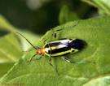
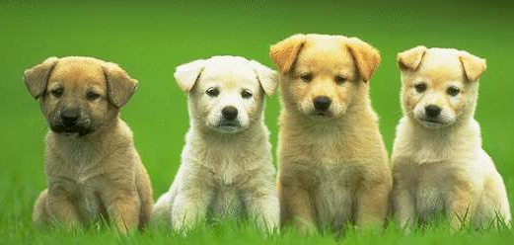
Inventions not Patentable
Section 3: What are not inventions (contd…)
Plants and animals in whole or any part thereof other than micro organisms but including seeds, varieties and species, essentially biological processes for production or propagation of plants and animals

Slide 31


Inventions not Patentable
Section 3: What are not inventions (contd…)
A mathematical or business method or a computer program per se or algorithms are not patentable
Example: New calculating machine which is a combination of hardware and software, is patentable
Note: Computer program alone is not patentable as such unless it controls a technical process or governs the operation of a technical device. E.g Embedded software is patentable since the software controls the operation of a device.

Slide 32
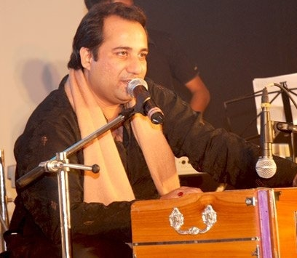

Inventions not Patentable
Section 3: What are not inventions (contd…)
Literary, dramatic, musical, artistic work, cinematographic works, television production

Slide 33
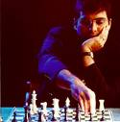
Inventions not Patentable
Section 3: What are not inventions (contd…)
Scheme, rules and methods for performing mental act or method of playing game
Ex: Method of learning language, playing chess, teaching, learning etc.
However, novel apparatus for playing game or carrying out a scheme is patentable

Slide 34

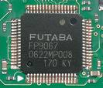
Inventions not Patentable
Section 3: What are not inventions (contd…)
A presentation of information
Ex: Any manner or method of expressing information whether by spoken words, Visual display, symbols, diagrams, Information recorded on a carrier
Topography of integrated circuits
Ex: Mask works- Circuit Layout
Special legislation called as Semiconductor Integrated Circuit Lay-out Design Act 2000 was enacted to protect IC

Slide 35



Inventions not Patentable
Section 3: What are not inventions (contd…)
Invention that in effect is traditional knowledge or which is an aggregation or duplication of known properties of traditionally known components.
However, any value-addition using Traditional Knowledge leading to a new process or product, which is novel, involves an inventive step and industrial applicability
Ex: Extraction of Azadirachtin from Neem can be patented

Slide 36

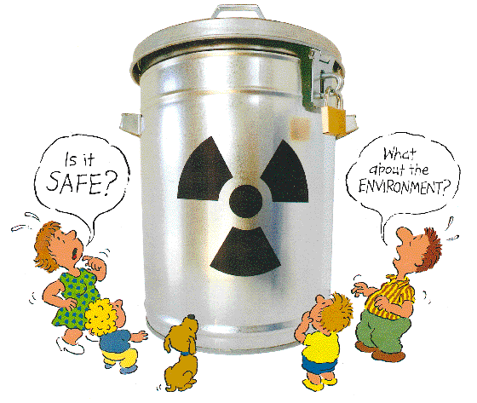
Inventions not Patentable
Section 4: Inventions relating to atomic energy
No patent shall be granted in respect of an invention relating to Atomic Energy falling within Section 20(1) of the Atomic Energy Act, 1962
No patent shall be granted for the invention which in the opinion of Central Government is useful for or related to the production, control, use or disposal of atomic energy or prospecting mining extraction, production, physical and chemical treatment fabrication, enrichment, canning or use of any prescribed substance or radioactive substance or the insuring of safety in atomic energy operation.

Slide 37
Inventions not Patentable
Section 20 of the Atomic Energy Act, 1962 (33 of 1962)
According to Section 20(1) of Atomic Energy Act, Atomic Energy means energy released from atomic nuclei as a result of any process including the fission and fusion processes.
“Prescribed substances” means a substance which may be used for the production or use of atomic energy or research into matters connected therewith and includes uranium, plutonium, thorium, beryllium, deuterium or any of these respective derivative or compounds or any other materials containing any of the aforesaid substances.
“Radioactive substances” or “radioactive material” means any substance or material, which spontaneously emits, radiation in excess of the levels prescribed by notification by the Central Government.

Slide 38

Agenda
1
Patentability Criteria
2
Types of Searches
3
Application for Patents
4
Types of Patent Applications
5
Patent Process

Slide 39

Brief glace on different types of searches
Novelty Search
Patentability Analysis
Freedom to Operate Analysis
Landscape Analysis
Infringement Analysis
Validity/Invalidity Search

Slide 40
Agenda
1
Patentability Criteria
2
Types of Searches
3
Application for Patents
4
Types of Patent Applications
5
Patent Process

Slide 41
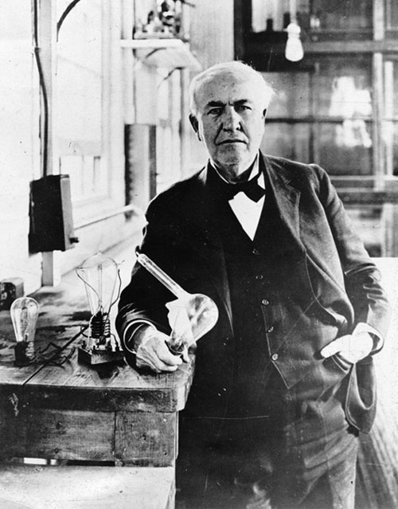
Application for patents
Who can file a patent?
Section 6: Persons entitled to apply for patents
True and first inventor of the invention
Assignee of true and first inventor
Legal Representative of a deceased person who immediately before his death was entitled to make such application
Application submitted either alone or jointly with other person.

Slide 42
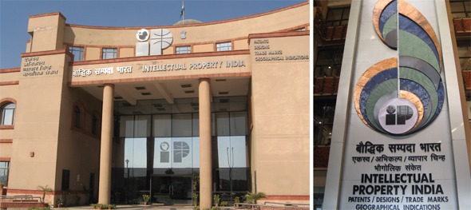
Application for patents
Rule 4: Appropriate office
Appropriate office is:
  Place of residence, domicile or place of business of the applicant or the place from where invention originated
  Address for service in India given by applicant where he has no place of business or domicile in India (Rule 5)
The appropriate office once decided will not ordinarily be changed

Slide 43
Application for patents
Patent Office | Territorial Jurisdiction
Mumbai | The States of Gujarat, Maharashtra, Madhya Pradesh, Goa, Chhattisgarh, Union territory of Daman Diu, Dadar & Nagar Haveli
Delhi | The States of Haryana, Himachal Pradesh, Punjab, Jammu & Kashmir, Rajasthan, Uttar Pradesh, Uttaranchal, National Capital Territory of Delhi, Union territory of Chandigarh
Chennai | The States of Andhra Pradesh, Karnataka, Kerala, Tamil Nadu and Union Territory of Pondicherry and Lakshadweep
Kolkata | Rest of India

Slide 44
Agenda
1
Patentability Criteria
2
Types of Searches
3
Application for Patents
4
Types of Patent Applications
5
Patent Process

Slide 45
Types of Application
Types of Application
Provisional Application
Complete Application
Internationall Application
  PCT Application
  Conventional Application
Divisional Application
Patent of Addition Application

Slide 46
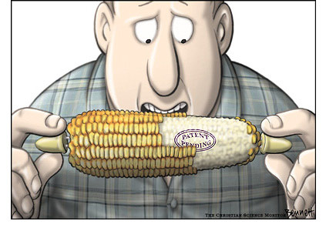
Types of Application
Provisional application
Get early priority
Not expensive
Quick
Title/Description
No claims
Cannot be filed in case of conventional/PCT/Divisional application
Filing provisional application is an optional but an advisable step

Slide 47

Types of Application
Complete specifications
Where an application for a patent is accompanied by a provisional specification, a complete specification shall be filed within twelve months from the date of filing of the application,. E.g.
Example
Provisional application: 01-12-2008
Complete specification: 01-12-2009

Slide 48
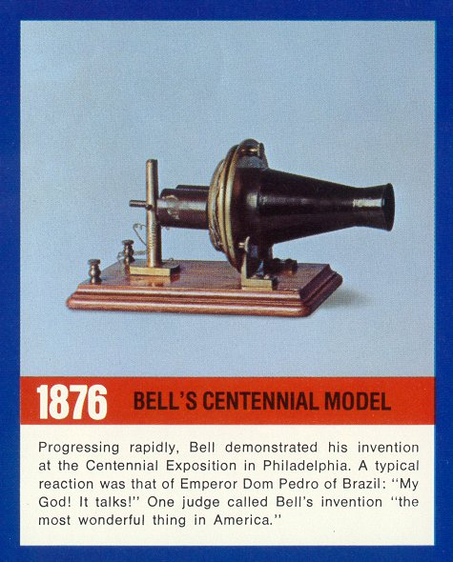
Types of Application
Section 10: Contents of specifications
Every specification shall start with a title sufficiently indicating subject matter.
Drawings
Model or sample illustrating the invention but such model or sample shall not be deemed to form part of the specification

Slide 49
Types of Application
Section 10: Contents of specifications (contd.)
Every complete specification shall—
  fully and particularly describe the invention and its operation or use and the method by which it is to be performed;
  disclose the best method of performing the invention which is known to the applicant and for which he is entitled to claim protection; and
  end with a claim or claims defining the scope of the invention for which protection is claimed;
  be accompanied by an abstract to provide technical information on the invention.

Slide 50
Types of Application
International application
  by PCT route – international filing system with one filing date in all the designated countries.
  by Conventional route – application for patent claiming – priority date based on the same application for patent filed in one or more of the convention countries.

Slide 51
Types of Application
PCT Application:
PCT application can also be filed pursuant to provisional application, within 1 year from date of earliest filed application
A national application has to be filed within 20/30/31 months from the priority date
Has to be accompanied by complete specification
National phase entry cannot be postponed and the non-compliance of the requirements would cause the application to be treated as abandoned.

Slide 52
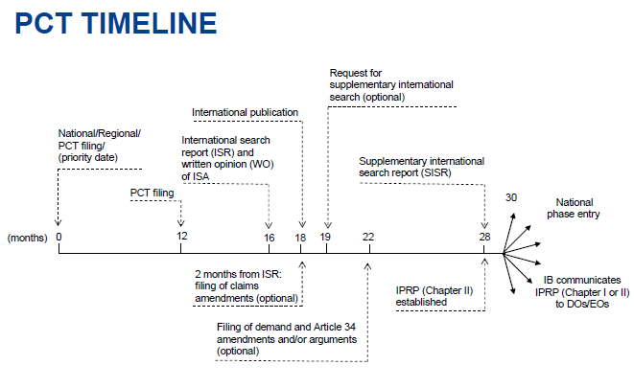
Types of Application

Slide 53
Types of Application
Convention Application:
Can directly file an application in other courtiers after filing the application in India
Convention application to be filed within 12 months from the date of filing a similar application in the convention country.
If any of the documents filed are in a foreign language, translation of the document has to be submitted

Slide 54
Types of Application
Application for Addition
enables the applicant to apply for an improvement or modifications made on the invention disclosed in the complete specification.
Improvement- must be more than a mere workshop improvement.
Divisional Application
A further application is filed, if the applicant desires/an objection is raised by the Controller on the ground that the claims of the complete specification relate to more than one invention.
The divisional application need to be filed before the grant of the patent

Slide 55



Publication and Examination
Section 11 A: Publication of Applications
No application shall be available to the public till 18 months of date of priority or date of filing whichever is earlier.
Applicant may request the controller for early using appropriate form and fees. The controller shall publish such application as soon as possible.
MONTHS
Section 11 B: Request for examination
Patent applications will not be examined unless requested in a prescribed manner
MONTHS

Slide 56
Publication and Examination
Rule 24-B: Examination of application
The request for examination of divisional application shall be made within 48 months from the date of filing of the application or from the date of priority of the first mentioned application or within 6 months from the date of filing of the further application, whichever is later.
Controller shall refer document to Examiner within 1 month from date of publication or date of receiving the request for examination, which ever is earlier.
Examiner shall prepare report in one month but not exceeding 3 months from date of reference of application to him by Controller.

Slide 57
Publication and Examination
Rule 24-B: Examination of application (contd.)
The period within which the Controller shall dispose off the report of the examiner shall ordinarily be one month from the date of the receipt of the such report by the Controller.
First Examination Report (FER) along with application and specification is sent to applicant or his agent ordinarily within 6 months from date of request of examination or within 6 months from date of publication whichever is later. In case other interested person files the request, an intimation is sent to such person.
Applicant shall comply with the requirement within 12 months from the date on which first statement of objection was issued. (section 21)

Slide 58
Agenda
1
Patentability Criteria
2
Types of Searches
3
Application for Patents
4
Types of Patent Applications
5
Patent Process

Slide 59


Patent process

Slide 60
Thank You!
Any questions?
Presented by SYED MURTUZA
Lead Patent Analyst – Level 2
ipMetrix Consulting Group
syed@ipmetrix.com
Mobile: +91-8892649982
www.ipmetrix.com

